Slide 1
The PyData Ecosystem

Slide 2
Points to include
I’d like to just list a few of the main packages and say a sentence or two about each one.
Also take some of the introduction Bill wrote for functional programming and put it to slides.
Numpy
Pandas
Scikit-Learn

Slide 3
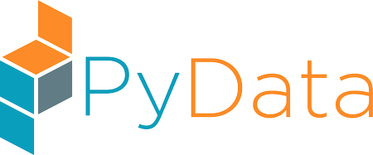



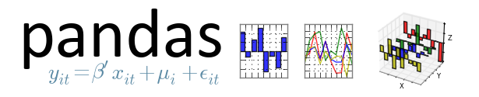



Creates open-source Python based data analysis technologies including…

Slide 4
IPython/Jupyter
What we’ve been using to teach you!
Super simple, sharable notebooks

Slide 5
NumPy
The underlying abstraction that sits below basically all of these libraries
Contains an efficient n-dimensional array representation
The first package we’ll be reviewing

Slide 6
pandas
A more user friendly interface for NumPy and SciPy
An excellent data manipulation framework
Be covered in the coming weeks

Slide 7
MatPlotLib
Plotting and graphics library
Good integration with pandas
Basics will be covered in the coming weeks

Slide 8
SciPy
Scientific computing framework
Sits on top of NumPy
Won’t be covered in this course (at least not directly)
Machine Learning Library
Won’t be covered in this course
Scikit-Learn/Scikit-Image

Slide 9
Summary
PyData is the most popular data analysis/numerical processing ecosystem in Python
Tools that you’re going to be using a lot over the coming months
Integral to pythonic data science

